Slide 1

Chapter 6 Arrays

Slide 2
Objectives
To describe why an array is necessary in programming (§6.1).
To learn how to declare an array (§6.2.1).
To access array elements using indexed variables (§6.2.2).
To initialize the values in an array (§6.2.3).
To develop and invoke functions with array arguments (§§6.3-6.4).
To search elements using the linear (§6.5.1) or binary search algorithm (§6.5.2).
To sort an array using the selection sort (§6.6.1)
(Optional) To sort an array using the insertion sort algorithms (§6.6.2).
To declare and create two-dimensional arrays (§6.7).
(Optional) To declare and create multidimensional arrays (§6.8).

Slide 3
Introducing Arrays
Often you will have to store a large number of values during the execution of a program. Suppose, for instance, that you want to read one hundred numbers, compute their average, and find out how many numbers are above the average. Your program first reads the numbers and compute their average and then compares each number with the average to determine whether it is above the average. The numbers all must be stored in variables in order to accomplish this task. You have to declare one hundred variables and repeatedly write almost identical code one hundred times. From the standpoint of practicality, it is impossible to write a program this way. An efficient, organized approach is needed. C++ and all other higher-level languages provide a data structure, the array, which stores a fixed-size sequential collection of elements with the same data type.

Slide 4
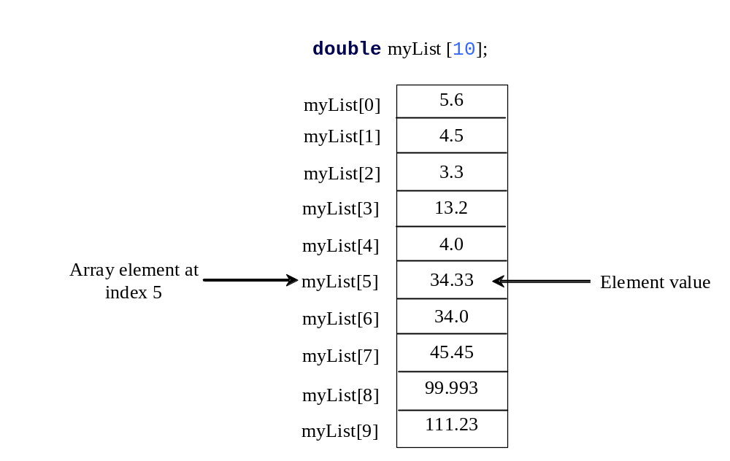
Introducing Arrays, cont.
Array is a data structure that represents a collection of the same types of data.

Slide 5
Declaring Array Variables
datatype arrayRefVar[arraySize];
Example:
double myList[10];
C++ requires that the array size used to declare an array must be a constant expression. For example, the following code is illegal:
int size = 4;
double myList[size]; // Wrong
But it would be OK, if size is a constant as follow:
const int size = 4;
double myList[size]; // Correct

Slide 6
Arbitrary Initial Values
When an array is created, its elements are assigned with arbitrary values.
Notes:
Arbitrary adj. 任意的

Slide 7
Indexed Variables
The array elements are accessed through the index. Array indices are 0-based; that is, they start from 0 to arraySize-1. In the example in Figure 6.1, myList holds ten double values and the indices are from 0 to 9.
Each element in the array is represented using the following syntax, known as an indexed variable:
arrayName[index];
For example, myList[9] represents the last element in the array myList.

Slide 8
Using Indexed Variables
After an array is created, an indexed variable can be used in the same way as a regular variable. For example, the following code adds the value in myList[0] and myList[1] to myList[2].
  myList[2] = myList[0] + myList[1];

Slide 9
No Bound Checking
C++ does not check array’s boundary. So, accessing array elements using subscripts beyond the boundary (e.g., myList[-1] and myList[11]) does not does cause syntax errors, but the operating system might report a memory access violation.
Notes:
That is to say, ….do not cause syntax errors, but runtime errors.

Slide 10
Array Initializers
Declaring, creating, initializing in one step:
dataType arrayName[arraySize] = {value0, value1, ..., valuek};
double myList[4] = {1.9, 2.9, 3.4, 3.5};
Notes:
Just like the regular variable, we can declare, create and initialize array variables in one step.

Slide 11
Declaring, creating, initializing Using the Shorthand Notation
double myList[4] = {1.9, 2.9, 3.4, 3.5};
This shorthand notation is equivalent to the following statements:
double myList[4];
myList[0] = 1.9;
myList[1] = 2.9;
myList[2] = 3.4;
myList[3] = 3.5;

Slide 12
CAUTION
Using the shorthand notation, you have to declare, create, and initialize the array all in one statement. Splitting it would cause a syntax error. For example, the following is wrong:
  double myList[4];
  myList = {1.9, 2.9, 3.4, 3.5};
Notes:
Because myList is a constant address, which is the start address for the array variable.

Slide 13
Implicit Size
C++ allows you to omit the array size when declaring and creating an array using an initializer. For example, the following declaration is fine:
double myList[] = {1.9, 2.9, 3.4, 3.5};
C++ automatically figures out how many elements are in the array.

Slide 14
Partial Initialization
C++ allows you to initialize a part of the array. For example, the following statement assigns values 1.9, 2.9 to the first two elements of the array. The other two elements will be set to zero. Note that if an array is declared, but not initialized, all its elements will contain “garbage”, like all other local variables.
double myList[4] = {1.9, 2.9};

Slide 15
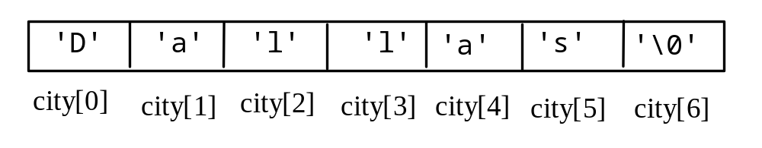
Initializing Character Arrays
char city[] = {'D', 'a', 'l', 'l', 'a', 's'};
char city[] = "Dallas";
This statement is equivalent to the preceding statement, except that C++ adds the character '\0', called the null terminator, to indicate the end of the string, as shown in Figure 6.2. Recall that a character that begins with the back slash symbol (\) is an escape character.

Slide 16
Initializing arrays with random values
The following loop initializes the array myList with random values between 0 and 99:
for (int i = 0; i < ARRAY_SIZE; i++)
{
myList[i] = rand() % 100;
}

Slide 17
Printing arrays
To print an array, you have to print each element in the array using a loop like the following:
for (int i = 0; i < ARRAY_SIZE; i++)
{
cout << myList[i] << " ";
}
Notes:
We know the size of the array. So, we prefer to use the for loop. Because array is a data structure to store several numbers with the same data type, loop statements are often used to operate array variable.

Slide 18
Printing Character Array
For a character array, it can be printed using one print statement. For example, the following code displays Dallas:
char city[] = "Dallas";
cout << city;
Notes:
This print statement is only for character array.

Slide 19
Copying Arrays
Can you copy array using a syntax like this?
list = myList;
This is not allowed in C++. You have to copy individual elements from one array to the other as follows:
for (int i = 0; i < ARRAY_SIZE; i++)
{
list[i] = myList[i];
}

Slide 20
Summing All Elements
Use a variable named total to store the sum. Initially total is 0. Add each element in the array to total using a loop like this:
double total = 0;
for (int i = 0; i < ARRAY_SIZE; i++)
{
total += myList[i];
}

Slide 21
Finding the Largest Element
Use a variable named max to store the largest element. Initially max is myList[0]. To find the largest element in the array myList, compare each element in myList with max, update max if the element is greater than max.
double max = myList[0];
for (int i = 1; i < ARRAY_SIZE; i++)
{
if (myList[i] > max) max = myList[i];
}

Slide 22
Example: Testing Arrays
Objective: The program receives 6 numbers from the user, finds the largest number and counts the occurrence of the largest number entered.
Suppose you entered 3, 5, 2, 5, 5, and 5, the largest number is 5 and its occurrence count is 4.
Test Array

Slide 23
Example: Assigning Grades
Objective: read student scores (int), get the best score, and then assign grades based on the following scheme:
  Grade is A if score is >= best–10;
  Grade is B if score is >= best–20;
  Grade is C if score is >= best–30;
  Grade is D if score is >= best–40;
  Grade is F otherwise.
AssignGrade

Slide 24
Passing Arrays to Functions
(04.18 t.b.c)
Just as you can pass single values to a function, you can also pass an entire array to a function. Listing 6.3 gives an example to demonstrate how to declare and invoke this type of functions.
PassArrayDemo

Slide 25
Pass-by-Reference
Passing an array variable means that the starting address of the array is passed to the formal parameter. The parameter inside the function references to the same array that is passed to the function. No new arrays are created. This is pass-by-reference.
PassByReferenceDemo

Slide 26
const Parameters
Passing arrays by reference makes sense for performance reasons. If an array is passed by value, all its elements must be copied into a new array. For large arrays, it could take some time and additional memory space. However, passing arrays by reference could lead to errors if your function changes the array accidentally. To prevent it from happening, you can put the const keyword before the array parameter to tell the compiler that the array cannot be changed. The compiler will report errors if the code in the function attempts to modify the array.
ConstArrayDemo
Compile error

Slide 27
Returning Arrays from Functions
Can you return an array from a function using a similar syntax? For example, you may attempt to declare a function that returns a new array that is a reversal of an array as follows:
// Return the reversal of list
int[] reverse(const int list[], int size)
This is not allowed in C++.

Slide 28
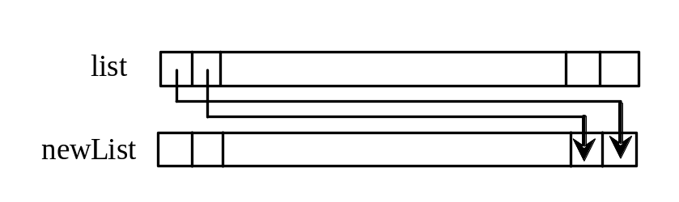
Returning Arrays from Functions, cont.
However, you can circumvent this restriction by passing two array arguments in the function, as follows:
// newList is the reversal of list
void reverse(const int list[], list newList[], int size)
ReverseArray
Notes:
circumvent 规避

Slide 29
Trace the reverse Function
animation
int list1[] = {1, 2, 3, 4, 5, 6};
reverse(list1, list2);
void reverse(const int list[], int newList[], int size)
{
for (int i = 0, j = size - 1; i < size; i++, j--)
{
newList[j] = list[i];
}
}
list
1
2
3
4
5
6
newList
0
0
0
0
0
0

Slide 30
Trace the reverse Method, cont.
animation
int list1[] = {1, 2, 3, 4, 5, 6};
reverse(list1, list2);
i = 0 and j = 5
void reverse(const int list[], int newList[], int size)
{
for (int i = 0, j = size - 1; i < size; i++, j--)
{
newList[j] = list[i];
}
}
list
1
2
3
4
5
6
newList
0
0
0
0
0
0

Slide 31
Trace the reverse Method, cont.
animation
int list1[] = {1, 2, 3, 4, 5, 6};
reverse(list1, list2);
i (= 0) is less than 6
void reverse(const int list[], int newList[], int size)
{
for (int i = 0, j = size - 1; i < size; i++, j--)
{
newList[j] = list[i];
}
}
list
1
2
3
4
5
6
newList
0
0
0
0
0
0

Slide 32
Trace the reverse Method, cont.
animation
int list1[] = {1, 2, 3, 4, 5, 6};
reverse(list1, list2);
void reverse(const int list[], int newList[], int size)
{
for (int i = 0, j = size - 1; i < size; i++, j--)
{
newList[j] = list[i];
}
}
i = 0 and j = 5
Assign list[0] to result[5]
list
1
2
3
4
5
6
newList
0
0
0
0
0
1

Slide 33
Trace the reverse Method, cont.
animation
int list1[] = {1, 2, 3, 4, 5, 6};
reverse(list1, list2);
void reverse(const int list[], int newList[], int size)
{
for (int i = 0, j = size - 1; i < size; i++, j--)
{
newList[j] = list[i];
}
}
After this, i becomes 1 and j becomes 4
list
1
2
3
4
5
6
newList
0
0
0
0
0
1

Slide 34
Trace the reverse Method, cont.
animation
int list1[] = {1, 2, 3, 4, 5, 6};
reverse(list1, list2);
i (=1) is less than 6
void reverse(const int list[], int newList[], int size)
{
for (int i = 0, j = size - 1; i < size; i++, j--)
{
newList[j] = list[i];
}
}
list
1
2
3
4
5
6
newList
0
0
0
0
0
1

Slide 35
Trace the reverse Method, cont.
animation
int list1[] = {1, 2, 3, 4, 5, 6};
reverse(list1, list2);
void reverse(const int list[], int newList[], int size)
{
for (int i = 0, j = size - 1; i < size; i++, j--)
{
newList[j] = list[i];
}
}
i = 1 and j = 4
Assign list[1] to result[4]
list
1
2
3
4
5
6
newList
0
0
0
0
2
1

Slide 36
Trace the reverse Method, cont.
animation
int list1[] = {1, 2, 3, 4, 5, 6};
reverse(list1, list2);
void reverse(const int list[], int newList[], int size)
{
for (int i = 0, j = size - 1; i < size; i++, j--)
{
newList[j] = list[i];
}
}
After this, i becomes 2 and j becomes 3
list
1
2
3
4
5
6
newList
0
0
0
0
2
1

Slide 37
Trace the reverse Method, cont.
animation
int list1[] = {1, 2, 3, 4, 5, 6};
reverse(list1, list2);
void reverse(const int list[], int newList[], int size)
{
for (int i = 0, j = size - 1; i < size; i++, j--)
{
newList[j] = list[i];
}
}
i (=2) is still less than 6
list
1
2
3
4
5
6
newList
0
0
0
0
2
1

Slide 38
Trace the reverse Method, cont.
animation
int list1[] = {1, 2, 3, 4, 5, 6};
reverse(list1, list2);
void reverse(const int list[], int newList[], int size)
{
for (int i = 0, j = size - 1; i < size; i++, j--)
{
newList[j] = list[i];
}
}
i = 2 and j = 3
Assign list[i] to result[j]
list
1
2
3
4
5
6
newList
0
0
0
3
2
1

Slide 39
Trace the reverse Method, cont.
animation
int list1[] = {1, 2, 3, 4, 5, 6};
reverse(list1, list2);
void reverse(const int list[], int newList[], int size)
{
for (int i = 0, j = size - 1; i < size; i++, j--)
{
newList[j] = list[i];
}
}
After this, i becomes 3 and j becomes 2
list
1
2
3
4
5
6
newList
0
0
0
3
2
1

Slide 40
Trace the reverse Method, cont.
animation
int list1[] = {1, 2, 3, 4, 5, 6};
reverse(list1, list2);
void reverse(const int list[], int newList[], int size)
{
for (int i = 0, j = size - 1; i < size; i++, j--)
{
newList[j] = list[i];
}
}
i (=3) is still less than 6
list
1
2
3
4
5
6
newList
0
0
0
3
2
1

Slide 41
Trace the reverse Method, cont.
animation
int list1[] = {1, 2, 3, 4, 5, 6};
reverse(list1, list2);
void reverse(const int list[], int newList[], int size)
{
for (int i = 0, j = size - 1; i < size; i++, j--)
{
newList[j] = list[i];
}
}
i = 3 and j = 2
Assign list[i] to result[j]
list
1
2
3
4
5
6
newList
0
0
4
3
2
1

Slide 42
Trace the reverse Method, cont.
animation
int list1[] = {1, 2, 3, 4, 5, 6};
reverse(list1, list2);
void reverse(const int list[], int newList[], int size)
{
for (int i = 0, j = size - 1; i < size; i++, j--)
{
newList[j] = list[i];
}
}
After this, i becomes 4 and j becomes 1
list
1
2
3
4
5
6
newList
0
0
4
3
2
1

Slide 43
Trace the reverse Method, cont.
animation
int list1[] = {1, 2, 3, 4, 5, 6};
reverse(list1, list2);
void reverse(const int list[], int newList[], int size)
{
for (int i = 0, j = size - 1; i < size; i++, j--)
{
newList[j] = list[i];
}
}
i (=4) is still less than 6
list
1
2
3
4
5
6
newList
0
0
4
3
2
1

Slide 44
Trace the reverse Method, cont.
animation
int list1[] = {1, 2, 3, 4, 5, 6};
reverse(list1, list2);
void reverse(const int list[], int newList[], int size)
{
for (int i = 0, j = size - 1; i < size; i++, j--)
{
newList[j] = list[i];
}
}
i = 4 and j = 1
Assign list[i] to result[j]
list
1
2
3
4
5
6
newList
0
5
4
3
2
1

Slide 45
Trace the reverse Method, cont.
animation
int list1[] = {1, 2, 3, 4, 5, 6};
reverse(list1, list2);
void reverse(const int list[], int newList[], int size)
{
for (int i = 0, j = size - 1; i < size; i++, j--)
{
newList[j] = list[i];
}
}
After this, i becomes 5 and j becomes 0
list
1
2
3
4
5
6
newList
0
5
4
3
2
1

Slide 46
Trace the reverse Method, cont.
animation
int list1[] = {1, 2, 3, 4, 5, 6};
reverse(list1, list2);
void reverse(const int list[], int newList[], int size)
{
for (int i = 0, j = size - 1; i < size; i++, j--)
{
newList[j] = list[i];
}
}
i (=5) is still less than 6
list
1
2
3
4
5
6
newList
0
5
4
3
2
1

Slide 47
Trace the reverse Method, cont.
animation
int list1[] = {1, 2, 3, 4, 5, 6};
reverse(list1, list2);
void reverse(const int list[], int newList[], int size)
{
for (int i = 0, j = size - 1; i < size; i++, j--)
{
newList[j] = list[i];
}
}
i = 5 and j = 0
Assign list[i] to result[j]
list
1
2
3
4
5
6
newList
6
5
4
3
2
1

Slide 48
Trace the reverse Method, cont.
animation
int list1[] = {1, 2, 3, 4, 5, 6};
reverse(list1, list2);
void reverse(const int list[], int newList[], int size)
{
for (int i = 0, j = size - 1; i < size; i++, j--)
{
newList[j] = list[i];
}
}
After this, i becomes 6 and j becomes -1
list
1
2
3
4
5
6
newList
6
5
4
3
2
1

Slide 49
Trace the reverse Method, cont.
animation
int list1[] = {1, 2, 3, 4, 5, 6};
reverse(list1, list2);
void reverse(const int list[], int newList[], int size)
{
for (int i = 0, j = size - 1; i < size; i++, j--)
{
newList[j] = list[i];
}
}
i (=6) < 6 is false. So exit the loop.
list
1
2
3
4
5
6
newList
6
5
4
3
2
1

Slide 50
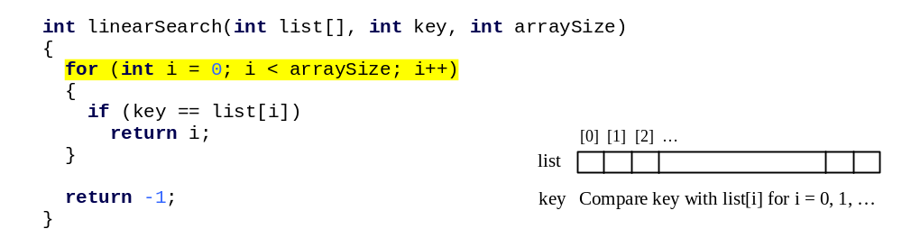
Searching Arrays
Searching is the process of looking for a specific element in an array; for example, discovering whether a certain score is included in a list of scores. Searching is a common task in computer programming. There are many algorithms and data structures devoted to searching. In this section, two commonly used approaches are discussed, linear search and binary search.

Slide 51
Linear Search
The linear search approach compares the key element, key, sequentially with each element in the array list. The method continues to do so until the key matches an element in the list or the list is exhausted without a match being found. If a match is made, the linear search returns the index of the element in the array that matches the key. If no match is found, the search returns -1.

Slide 52
Linear Search Animation
animation
Key
List
3
6 | 4 | 1 | 9 | 7 | 3 | 2 | 8
3
6 | 4 | 1 | 9 | 7 | 3 | 2 | 8
3
6 | 4 | 1 | 9 | 7 | 3 | 2 | 8
3
6 | 4 | 1 | 9 | 7 | 3 | 2 | 8
3
6 | 4 | 1 | 9 | 7 | 3 | 2 | 8
3
6 | 4 | 1 | 9 | 7 | 3 | 2 | 8

Slide 53
From Idea to Solution
Trace the function
int[] list = {1, 4, 4, 2, 5, -3, 6, 2};
int i = linearSearch(list, 4, 8); // returns 1
int j = linearSearch(list, -4, 8); // returns -1
int k = linearSearch(list, -3, 8); // returns 5

Slide 54
Binary Search
For binary search to work, the elements in the array must already be ordered. Without loss of generality, assume that the array is in ascending order.
  e.g., 2 4 7 10 11 45 50 59 60 66 69 70 79
The binary search first compares the key with the element in the middle of the array.

Slide 55
Binary Search, cont.
Consider the following three cases:
If the key is less than the middle element, you only need to search the key in the first half of the array.
If the key is equal to the middle element, the search ends with a match.
If the key is greater than the middle element, you only need to search the key in the second half of the array.

Slide 56
Binary Search
animation
Key
List
8
1 | 2 | 3 | 4 | 6 | 7 | 8 | 9
8
1 | 2 | 3 | 4 | 6 | 7 | 8 | 9
8
1 | 2 | 3 | 4 | 6 | 7 | 8 | 9

Slide 57
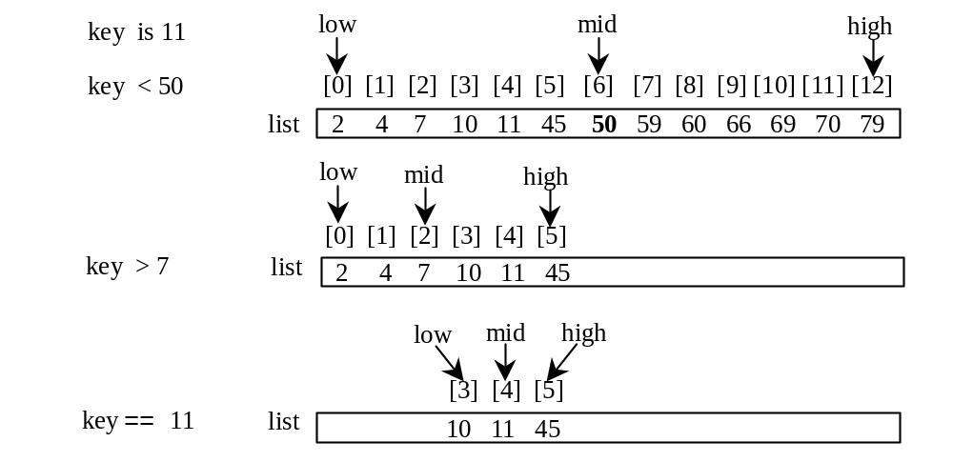
Binary Search, cont.

Slide 58
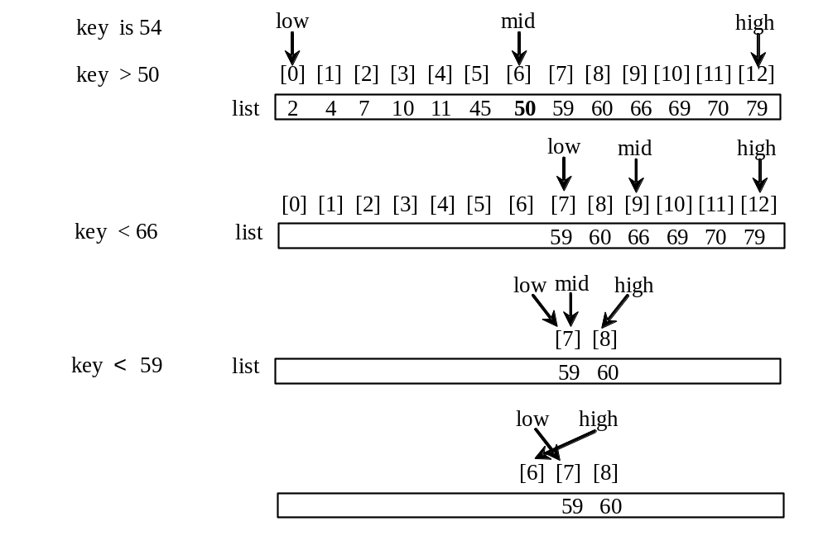
Binary Search, cont.

Slide 59
Binary Search, cont.
The binarySearch method returns the index of the search key if it is contained in the list. Otherwise, it returns –insertion point - 1. The insertion point is the point at which the key would be inserted into the list.

Slide 60
From Idea to Soluton
int binarySearch(int list[], int key, int arraySize)
{
int low = 0;
int high = arraySize - 1;
while (high >= low)
{
int mid = (low + high) / 2;
if (key < list[mid])
high = mid - 1;
else if (key == list[mid])
return mid;
else
low = mid + 1;
}
return –1;
}

Slide 61
Sorting Arrays
Sorting, like searching, is also a common task in computer programming. It would be used, for instance, if you wanted to display the grades from Listing 6.2, AssignGrade.cpp, in alphabetical order. Many different algorithms have been developed for sorting. This section introduces two simple, intuitive sorting algorithms: selection sort and insertion sort.

Slide 62
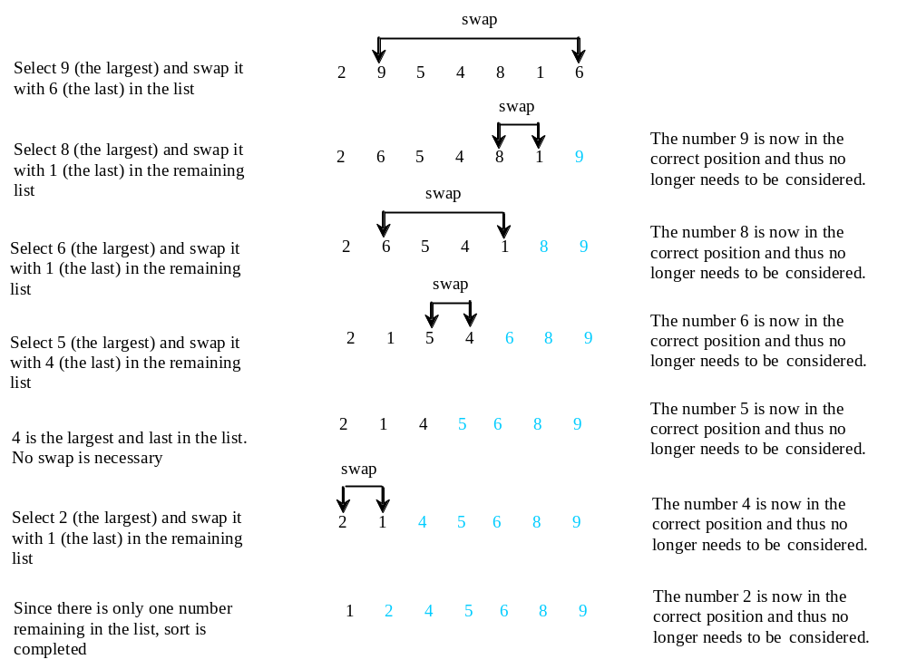
Selection Sort
Selection sort finds the largest number in the list and places it last. It then finds the largest number remaining and places it next to last, and so on until the list contains only a single number. Figure 6.17 shows how to sort the list {2, 9, 5, 4, 8, 1, 6} using selection sort.

Slide 63
Selection Sort
animation
int[] myList = {2, 9, 5, 4, 8, 1, 6}; // Unsorted
2 | 9 | 5 | 4 | 8 | 1 | 6
2 | 6 | 5 | 4 | 8 | 1 | 9
2 | 6 | 5 | 4 | 1 | 8 | 9
2 | 1 | 5 | 4 | 6 | 8 | 9
2 | 1 | 4 | 5 | 6 | 8 | 9
2 | 1 | 4 | 5 | 6 | 8 | 9
1 | 2 | 4 | 5 | 6 | 8 | 9

Slide 64
From Idea to Solution
for (int i = listSize - 1; i >= 1; i--)
{
select the largest element in list[0..i];
swap the largest with list[i], if necessary;
// list[i] is in its correct position.
// The next iteration apply on list[0..i-1]
}
list[0] list[1] list[2] list[3] ... list[10]
list[0] list[1] list[2] list[3] ... list[9]
list[0] list[1] list[2] list[3] ... list[8]
list[0] list[1] list[2] list[3] ... list[7]
...
list[0]

Slide 65
Expand
for (int i = listSize - 1; i >= 1; i--)
{
select the largest element in list[0..i];
swap the largest with list[i], if necessary;
// list[i] is in its correct position.
// The next iteration apply on list[0..i-1]
}
// Find the maximum in the list[0..i]
double currentMax = list[0];
int currentMaxIndex = 0;
for (int j = 1; j <= i; j++)
{
if (currentMax < list[j])
{
currentMax = list[j];
currentMaxIndex = j;
}
}

Slide 66
Expand
for (int i = list.length - 1; i >= 1; i--)
{
select the largest element in list[0..i];
swap the largest with list[i], if necessary;
// list[i] is in place. The next iteration applies on list[0..i-1]
}
// Find the maximum in the list[0..i]
double currentMax = list[0];
int currentMaxIndex = 0;
for (int j = 1; j <= i; j++)
{
if (currentMax < list[j])
{
currentMax = list[j];
currentMaxIndex = j;
}
}

Slide 67
Expand
for (int i = list.length - 1; i >= 1; i--)
{
select the largest element in list[0..i];
swap the largest with list[i], if necessary;
// list[i] is in place. The next iteration applies on list[0..i-1]
}
// Swap list[i] with list[currentMaxIndex] if necessary;
if (currentMaxIndex != i)
{
list[currentMaxIndex] = list[i];
list[i] = currentMax;
}

Slide 68
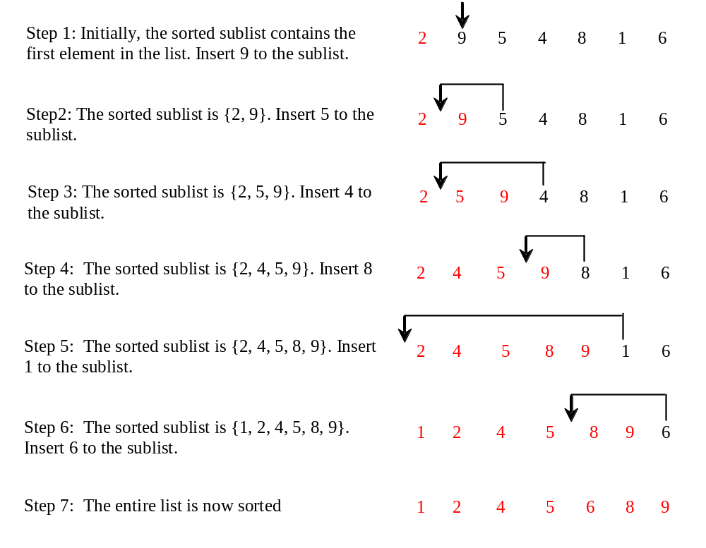
Insertion Sort
Optional
int[] myList = {2, 9, 5, 4, 8, 1, 6}; // Unsorted
The insertion sort algorithm sorts a list of values by repeatedly inserting an unsorted element into a sorted sublist until the whole list is sorted.

Slide 69
Insertion Sort
animation
int[] myList = {2, 9, 5, 4, 8, 1, 6}; // Unsorted
2 | 9 | 5 | 4 | 8 | 1 | 6
2 | 9 | 5 | 4 | 8 | 1 | 6
2 | 5 | 9 | 4 | 8 | 1 | 6
2 | 4 | 5 | 9 | 8 | 1 | 6
2 | 4 | 5 | 8 | 9 | 1 | 6
1 | 2 | 4 | 5 | 8 | 9 | 6
1 | 2 | 4 | 5 | 6 | 8 | 9

Slide 70
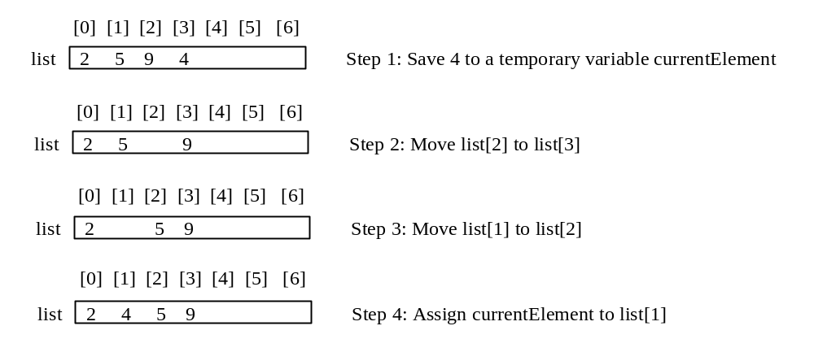
How to Insert?
Optional
The insertion sort algorithm sorts a list of values by repeatedly inserting an unsorted element into a sorted sublist until the whole list is sorted.

Slide 71
Two-dimensional Arrays
// Declare array ref var
dataType arrayName[rowSize][columnSize];
int matrix[5][5];

Slide 72
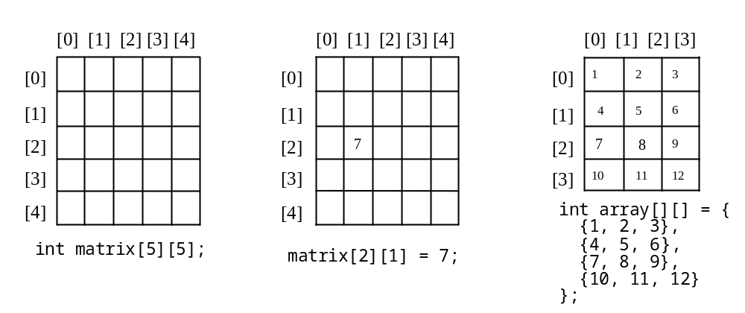
Two-dimensional Array Illustration
Notes:
The row and column are both 0-based.

Slide 73
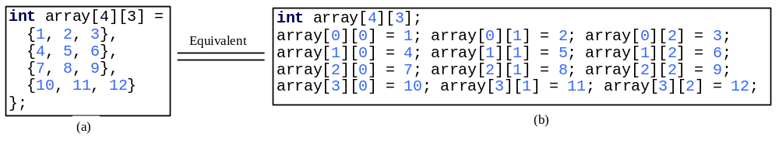
Declaring, Creating, and Initializing Using Shorthand Notations
You can also use an array initializer to declare, create and initialize a two-dimensional array. For example,

Slide 74
Initializing Arrays with Random Values
The following loop initializes the array with random values between 0 and 99:
for (int row = 0; row < rowSize; row++)
{
for (int column = 0; column < columnSize; column++)
{
matrix[row][column] = rand() % 100;
}
}

Slide 75
Printing Arrays
To print a two-dimensional array, you have to print each element in the array using a loop like the following:
for (int row = 0; row < rowSize; row++)
{
for (int column = 0; column < columnSize; column++)
{
cout << matrix[row][column] << " ";
}
cout << endl;
}

Slide 76
Summing All Elements
To print a two-dimensional array, you have to print each element in the array using a loop like the following:
for (int row = 0; row < rowSize; row++)
{
for (int column = 0; column < columnSize; column++)
{
cout << matrix[row][column] << " ";
}
cout << endl;
}

Slide 77
Summing Elements by Column
For each column, use a variable named total to store its sum. Add each element in the column to total using a loop like this:
for (int column = 0; column < columnSize; column++)
{
int total = 0;
for (int row = 0; row < rowSize; row++)
total += matrix[row][column];
cout << "Sum for column " << column << " is " << total << endl;
}

Slide 78
Which row has the largest sum?
Use variables maxRow and indexOfMaxRow to track the largest sum and index of the row. For each row, compute its sum and update maxRow and indexOfMaxRow if the new sum is greater.

Slide 79
Passing Two-Dimensional Arrays to Functions
You can pass a two-dimensional array to a function; however, C++ requires that the column size to be specified in the function declaration. Listing 6.11 gives an example with a function that returns the sum of all the elements in a matrix.
PassTwoDimensionalArray

Slide 80
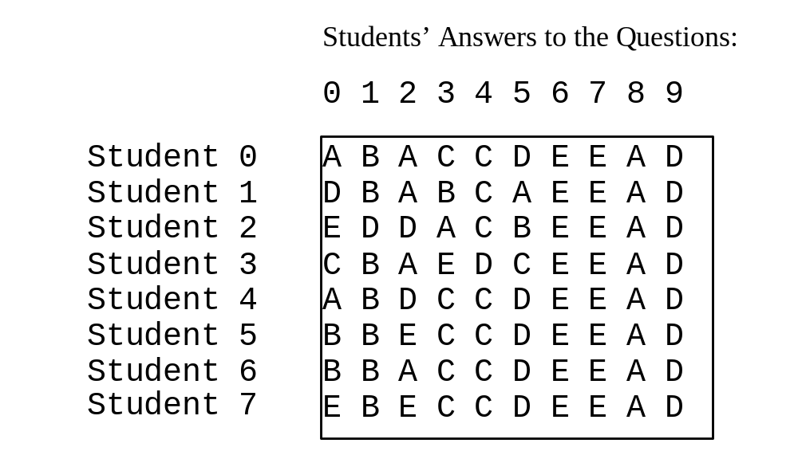
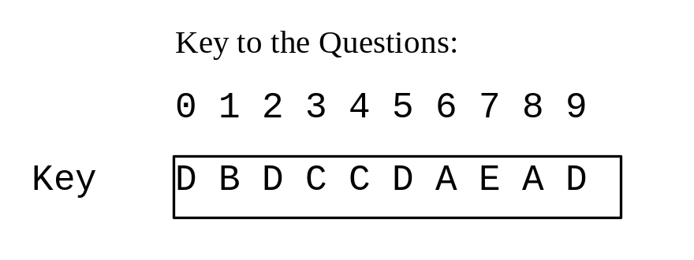
Example: Grading Multiple-Choice Test
Objective: write a program that grades multiple-choice test.
GradeExam

Slide 81
Multidimensional Arrays
In the preceding section, you used a two-dimensional array to represent a matrix or a table. Occasionally, you will need to represent n-dimensional data structures. In C++, you can create n-dimensional arrays for any integer n.
The way to declare two-dimensional array can be generalized to declare n-dimensional array for n >= 3. For example, the following syntax declares a three-dimensional array scores.
double scores[10][5][2];

Slide 82
Example: Calculating Total Scores
Objective: write a program that calculates the total score for students in a class. Suppose the scores are stored in a three-dimensional array named scores. The first index in scores refers to a student, the second refers to an exam, and the third refers to the part of the exam. Suppose there are 7 students, 5 exams, and each exam has two parts--the multiple-choice part and the programming part. So, scores[i][j][0] represents the score on the multiple-choice part for the i’s student on the j’s exam. Your program displays the total score for each student.
TotalScore

Slide 83
Chapter Summary
An array represents a list of values of the same type. An array is created using the syntax dataType arrayName[size].
Each element in the array is represented using the syntax arrayName[index]. An index must be an integer or an integer expression. Array index is 0-based, meaning that the index for the first element is 0.
Notes:
Circumvent 规避

Slide 84
Chapter Summary
Programmers often mistakenly reference the first element in an array with index 1, so that the index of the tenth element becomes 10. This is called the index off-by-one error.
C++ has a shorthand notation, known as the array initializer, which combines creating an array and initializing in one statement using the syntax: dataType arrayName[]={value0,value1,…,valuek} .
Notes:
Circumvent 规避

Slide 85
Chapter Summary
When you pass an array argument to a function, you are actually passing the reference of the array: that is, the called function can modify the elements in the caller’s original array.
When you pass an array argument to a function, often you also should pass the size in another argument, so the function knows how many elements are in the functions.
Notes:
Circumvent 规避

Slide 86
Chapter Summary
You can specify const array paramenters to prevent arrays from being modified accidentally.
You can use arrays of arrays to form multidimensional arrays. For example, a two-dimensional array is declared as an array of arrays using the syntax dataType arrayName[size][size].
Notes:
Circumvent 规避

